Slide 1
PSCS-18 DASHBOARD FOR REAL-TIME MONITORING OF CONSTRUCTION PROJECTS
Review-0
Batch Number: CSE-G74
Under the Supervision of,
Dr. PRASAD P S
Assistant Professor ( Selection Grade )
School of Computer Science and Engineering
Presidency University
Roll Number | Student Name
20211CSE0497 | YASHAS R GOWDA
20211CSE0843 | SHASHANK K
20211CSE0847 | DISHA S
Name of the Program: PSCS
Name of the HoD: Dr. ASIF MOHAMMED H B
Name of the Program Project Coordinator: Mr. AMARNATH J L & Dr. JAYANTHI K
Name of the School Project Coordinators: Dr. ABDUL KHADAR A

Slide 2
CONTENT
Problem Statement
Github Link
Literature Survey
Finalized objectives
Methodology
Timeline of the Project
Conclusion
References

Slide 3
PROBLEM STATEMENT NUMBER: PSCS-18
Organization: Ministry of Power
Category (Hardware / Software / Both) : Software
Problem Description: Designing of dashboards for Real-time monitoring of Construction projects using IOT devices and backend Artificial intelligence/ML tools to track Resources in the form of equipment/manpower, monitor their efficiency and safety in all situations.
Difficulty Level: Simple

Slide 4
PROBLEM STATEMENT NUMBER: PSCS-18
"Real-Time Monitoring Dashboard for Construction Projects Using MERN Stack with PostgreSQL"
The title highlights the focus on real-time monitoring and data visualization for construction project management.
The use of the MERN stack and PostgreSQL ensures modern technology adoption and scalable solutions.
The project excludes IoT/AI integrations, focusing purely on comprehensive web-based dashboards for resource and task tracking.

Slide 5
GITHUB LINK
https://github.com/Yashas-PU/Dashboard-for-real-time-monitoring-of-construction-projects.
It’s a public repository and everything is accessible for everyone and there is a through road map how we are going to take this project further in a readme file in Github

Slide 6
LITERATURE SURVEY
The literature survey aims to explore existing solutions for construction project management, their limitations, and the potential of web-based dashboards.
Existing Solutions:
Primavera P6
Popular construction project management software but lacks customization for specific project needs.
Expensive licensing makes it unsuitable for small to mid-scale companies.
Microsoft Project
Focused on task scheduling but provides limited real-time resource and efficiency tracking.
Lacks modern web-based visualization.
Procore
Highly advanced but heavily integrated with IoT and AI, which increases system complexity and cost.

Slide 7
LITERATURE SURVEY
Identified Gaps in Existing Systems:
Lack of affordable, lightweight dashboards for resource tracking and performance monitoring.
Limited support for user-friendly web-based tools in small-scale construction projects.
Dependence on external integrations (IoT, AI) that might not always be practical.
Proposed Solution:
A web-based dashboard built with MERN Stack, utilizing PostgreSQL as the database.
Focus on modularity and ease of use with real-time data visualization.
Comprehensive CRUD capabilities for projects, resources, tasks, and reports.
Avoiding unnecessary complexities like IoT or AI while ensuring efficiency.

Slide 8
FINALIZED OBJECTIVES
The project aims to achieve the following objectives:
Real-Time Resource Monitoring:
Provide live updates on manpower and equipment allocation, usage, and availability.
Task and Workflow Management:
Enable tracking of tasks' progress, status, deadlines, and assigned personnel.
Efficiency Metrics:
Display key metrics like resource utilization rates, task completion rates, and project budget adherence.
Interactive Dashboard:
Include charts, graphs, and tables to offer dynamic insights into project performance.

Slide 9
FINALIZED OBJECTIVES
CRUD Operations:
Provide full Create, Read, Update, Delete functionality for projects, tasks, and resources.
Scalable Backend:
Use PostgreSQL for robust database management and Express.js for scalable API services.
Responsive Frontend:
Build a fully responsive React-based dashboard for seamless accessibility across devices.
User Authentication:
Implement a secure admin authentication system with role-based access control.

Slide 10
METHODOLOGY
Project Workflow:
The project will follow an iterative development approach with the following phases:
Phase 1: Requirements Gathering and System Design
Discuss requirements with the supervisor and finalize the system architecture.
Prepare a detailed ER diagram for database schema design.
Phase 2: Backend Development
Setup PostgreSQL Database:
Create tables for projects, resources, tasks, users, and reports.
Develop RESTful APIs:
Implement endpoints for CRUD operations and metrics calculation.

Slide 11
METHODOLOGY
Phase 3: Frontend Development
Build an interactive React-based admin dashboard.
Implement dynamic charts, graphs, and tables using libraries like Chart.js and Recharts.
Phase 4: Integration
Connect the frontend with the backend via Axios for API calls.
Ensure secure user authentication using JWT.
Phase 5: Testing and Optimization
Test the system for edge cases, scalability, and responsiveness.
Optimize database queries and improve API performance.
Phase 6: Deployment
Deploy the backend using platforms like Railway or Render.
Deploy the frontend on Netlify or Vercel.

Slide 12
METHODOLOGY
Key Deliverables at Each Phase:
Phase 1: System architecture, ER diagram, and finalized database schema.
Phase 2: Completed backend with APIs ready for integration.
Phase 3: Functional frontend with key components like dashboard, charts, and CRUD forms.
Phase 4: Fully integrated and functional admin dashboard.
Phase 5: Tested and optimized project with all metrics accurately displayed.
Phase 6: Fully deployed and operational dashboard accessible to stakeholders.

Slide 13
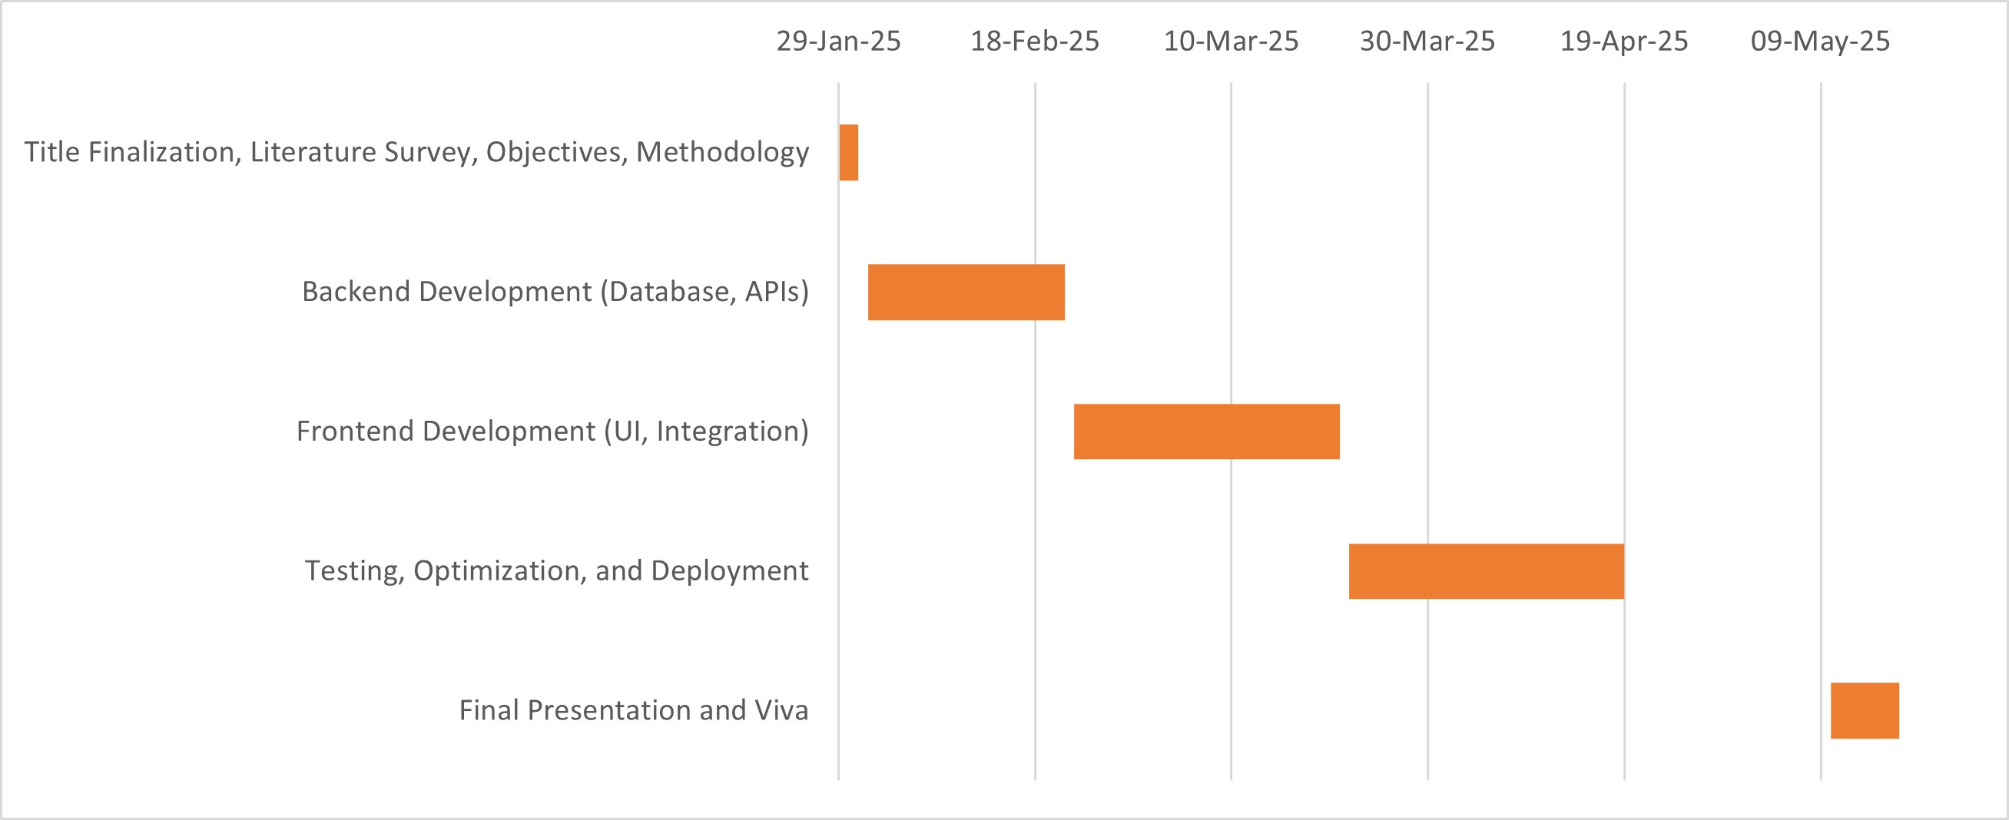
TIMELINE OF THE PROJECT

Slide 14
CONCLUSION
This review presents the finalized title, identified gaps in existing systems, clear objectives,time line of the project and a step-by-step methodology for developing a Real-Time Construction Project Monitoring Dashboard using the MERN stack and PostgreSQL.
The approach focuses on delivering a modern, user-friendly solution tailored for the construction industry.

Slide 15
REFERENCES
"Real-Time Monitoring of Construction Sites: Sensors, Methods, and Applications".
"Use of Visual Dashboards in Construction Projects".
"Developing an Environmental Monitoring Dashboard to Identify Construction Impacts".
"An Overview for Road Construction Work Progress Monitoring".
"Developing a Project Status Dashboard for Construction Project Progress Reporting".
"A Study on Development of Real-Time Monitoring System for Field Construction Management".
"The Feasibility of Real-Time Location Systems in Construction".
"Computer Vision for Construction Progress Monitoring: A Real-Time Object Detection Approach".
"A Robotic Cyber-Physical System for Automated Reality Capture and Visualization in Construction Progress Monitoring".
"Building an Integrated Mobile Robotic System for Real-Time Applications in Construction".

Slide 16


